Slide 1
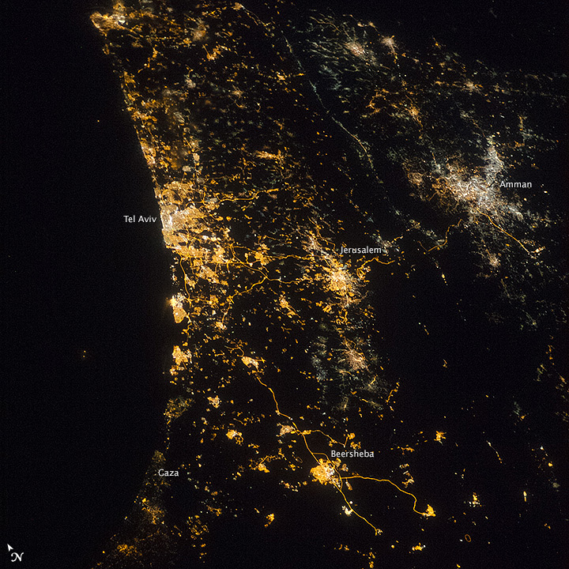
The Poor Chasing the Rich?
The Tiebout Model and Local Government Expenditures on Welfare
Tomer Chelouche
www.urbanizator.com

Slide 2
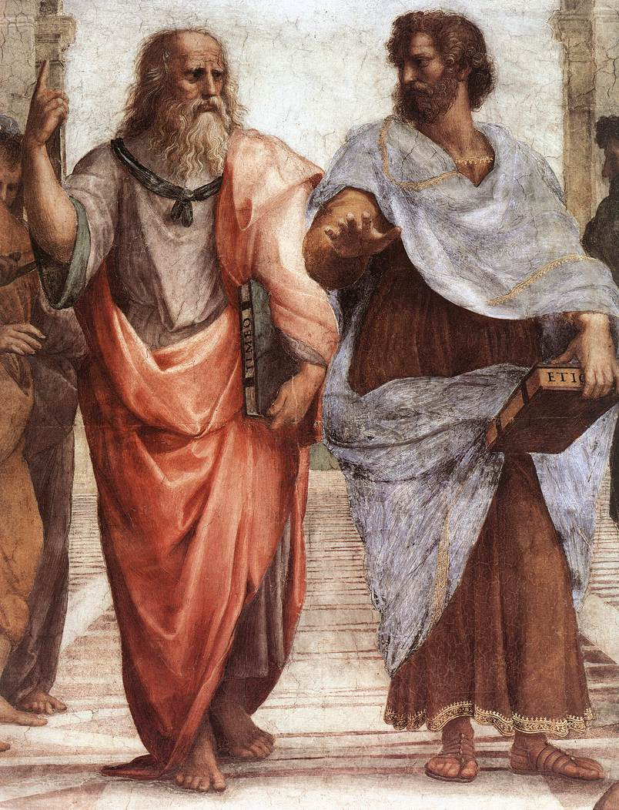
Introduction
Research question
Findings
Why is it important
Literature review
Hypotheses
Technical details
Results
Conclusion
Future research
Plato’s The Republic
“...any city, however small, is in fact divided into two, one the city of the poor, the other of the rich; these are at war with one another...”
“...let our city be accounted neither large nor small, but one and self-sufficing...”

Slide 3
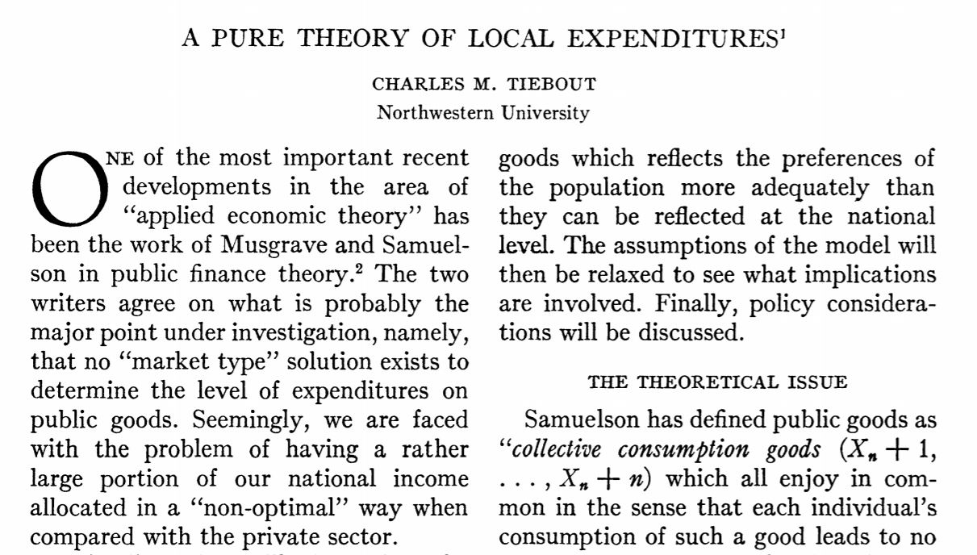
Introduction
Research question
Findings
Why is it important
Literature review
Hypotheses
Technical details
Results
Conclusion
Future research

Slide 4
Education
Welfare
Sanitation
Housing
Security
Tax
★★★★
★★
★★★
★★★★★
★★★★
$$$
Education
Welfare
Sanitation
Housing
Security
Tax
★★
★★★★
★★★★
★★★★★
★★★★
$$$$$
Introduction
Research question
Findings
Why is it important
Literature review
Hypotheses
Technical details
Results
Conclusion
Future research
Education
Welfare
Sanitation
Housing
Security
Tax
★★★★★
★★★
★★★★★
★★
★★★★★
$$$$
Education
Welfare
Sanitation
Housing
Security
Tax
★★★★★
★★★★
★★★★★
★★★★
★★
$$

Slide 5
How does greater municipal autonomy influence local expenditures on welfare?
How does greater need for welfare services influence local expenditures on welfare?
How does the interaction (between greater municipal autonomy and greater need for welfare services) influence local expenditures on welfare?
Introduction
Research question
Findings
Why is it important
Literature review
Hypotheses
Technical details
Results
Conclusion
Future research

Slide 6
⇑ Municipal autonomy
↳ Expenditures on welfare ⇓
⇑ Need for welfare services
↳ Expenditures on welfare ⇓
⇑ Interaction effect
↳ Expenditures on welfare ⇑
Introduction
Research question
Findings
Why is it important
Literature review
Hypotheses
Technical details
Results
Conclusion
Future research

Slide 7
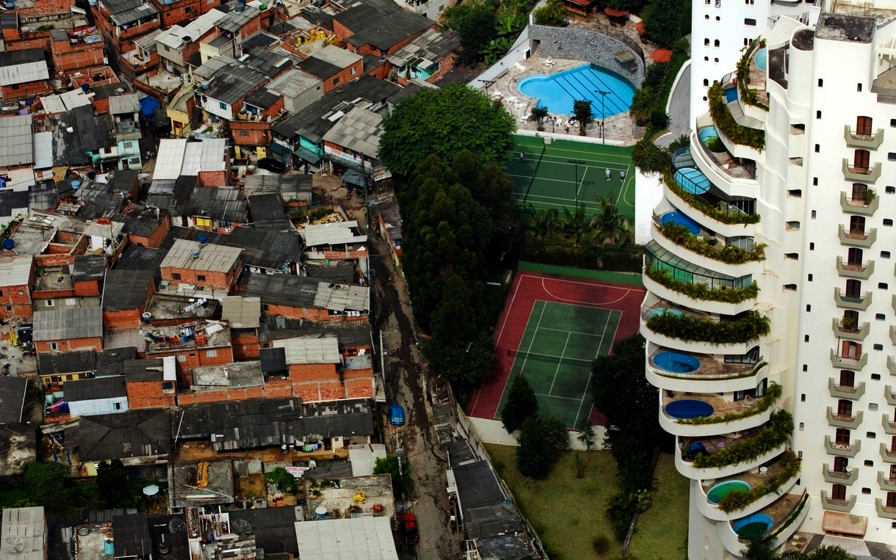
Introduction
Research question
Findings
Why is it important
Literature review
Hypotheses
Technical details
Results
Conclusion
Future research

Slide 8
Oates, 1969
Hamilton, 1975
Rose-Ackerman, 1981
Berglas, 1982
Keating, 1995
Caplan, 2001
Introduction
Research question
Findings
Why is it important
Literature review
Hypotheses
Technical details
Results
Conclusion
Future research

Slide 9
Introduction
Research question
Findings
Why is it important
Literature review
Hypotheses
Technical details
Results
Conclusion
Future research
$${WR}_{it}=α_{t}+β_{1}{AIR}_{it}+β_{2}{MW}_{it}+β_{3}{(AIR × MW)}_{it}+u_{it}$$
$$u_{it}= μ_{i}+v_{it}$$
WR_{it} – Welfare Rate for city i in year t
AIR_{it} – Auto-Investment Rate for city i in year t
MW_{it} – Percentage of employees earning up to minimum wage for city i in year t
u_{it} – error term = individual time-invariant effects (μ_{i}) + random effects (v_{it})

Slide 10
H₀: β₁ = 0 | Higher auto-investment rate has no impact on welfare rate
H₁: β₁ ≠ 0 | Higher auto-investment rate has an impact on welfare rate
H₀: β₂ = 0 | Higher percentage of employees earning up to minimum wage has no impact on welfare rate
H₂: β₂ ≠ 0 | Higher percentage of employees earning up to minimum wage has an impact on welfare rate to increase
H₀: β₃ = 0 | There is no interaction effect between higher auto- investment rate and percentage of employees earning up to minimum wage in terms of welfare rate.
H₃: β₃ ≠ 0 | There is an interaction effect between higher auto- investment rate and percentage of employees earning up to minimum wage in terms of welfare rate.
Introduction
Research question
Findings
Why is it important
Literature review
Hypotheses
Technical details
Results
Conclusion
Future research

Slide 11
Welfare services in Israel are considered as a national service, that local government is responsible to provide and the central government is responsible to provide for
Welfare matching agreement: 75% national, 25% local
------
Dataset was compiled of 74 cities between 2010-2014
Financial data taken from the Ministry of the Interior and socio-economic data taken from the Central Bureau of Statistic
Introduction
Research question
Findings
Why is it important
Literature review
Hypotheses
Technical details
Results
Conclusion
Future research

Slide 12
City | Year | expenditures on local services (1000 ILS) | expenditures on national services (1000 ILS) | earmarked allocations from the Ministry of Education (1000 ILS) | earmarked allocations from the Ministry of Welfare (1000 ILS) | percentage of the workforce earning up to the minimum wage | expenditures on welfare (1000 ILS)
 |  | (A) | (B) | (C) | (D) | (E) | (F)
ASHQELON | 2011 | 127817 | 318206 | 128864 | 57293 | 43.7 | 97470
Introduction
Research question
Findings
Why is it important
Literature review
Hypotheses
Technical details
Results
Conclusion
Future research
City | Year | Auto-investment rate (AIR) | Demand for welfare services (MW) | Interaction variable | Welfare rate
 |  | (A+B)-(C+D) / (A+B) | E / 100 | AIR * MW | F / (A+B)
ASHQELON | 2011 | 0.582629147 | 0.437 | 0.254608937 | 0.218531331

Slide 13
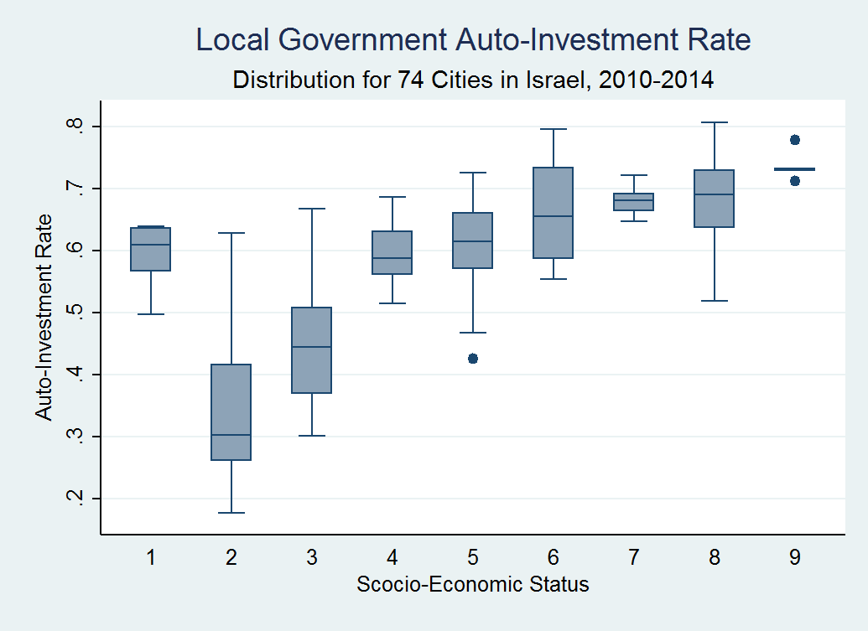
Introduction
Research question
Findings
Why is it important
Literature review
Hypotheses
Technical details
Results
Conclusion
Future research

Slide 14
Descriptive Statistics
Variable |  | Mean | Std. Dev. | Min | Max | Obs.
WR | overall | .1869912 | .0579008 | .0417776 | .3464584 | N = 368
 | between |  | .0525213 | .0574230 | .2963775 | n = 74
 | within |  | .0247298 | .1188069 | .2699350 | T-bar = 4.97297
AIR | overall | .5910935 | .1186918 | .1776933 | .8073689 | N = 368
 | between |  | .1185279 | .2032359 | .7900973 | n = 74
 | within |  | .0222842 | .5067407 | .6962155 | T-bar = 4.97297
MW | overall | .4084932 | .0829247 | .2400000 | .6490000 | N = 367
 | between |  | .0821885 | .2500000 | .6150000 | n = 74
 | within |  | .0140800 | .3854932 | .4470932 | T-bar = 4.95946
AIR*MW | overall | .2356424 | .0471679 | .0995082 | .4133576 | N = 367
 | between |  | .0454011 | .1171389 | .3748506 | n = 74
 | within |  | .0146043 | .1829406 | .3066173 | T-bar = 4.95946
Introduction
Research question
Findings
Why is it important
Literature review
Hypotheses
Technical details
Results
Conclusion
Future research

Slide 15
Estimation Results
WR | Pooled OLS regression | Between | Fixed effects | First differences | Random effects
AIR t = | -.9166372* (.1069348) -8.57 | -.9560549* (.2015568) -4.74 | -.1015892 (.2668464) -0.38 | -.044427 (.3947031) -0.11 | -.7035219* (.1588565) -4.43
MW t = | -.8252020* (.1391442) -5.93 | -.8839791* (.2623805) -3.37 | .6096341 (.6096341) 1.70 | 1.044943 (.5364154) 1.95 | -.5258673* (.2069506) -2.54
AIR*MW t = | 2.218499* (.2212535) 10.03 | 2.327649* (.4138580) 5.62 | -.0491316 (.5957321) -0.08 | -.161438 (.8768929) -0.18 | 1.689268* (.3391012) 4.98
Constant t = | .5439640* (.0693236) 7.85 | .5654149* (.1315293) 4.30 | .0098231 (.1604672) 0.06 | no constant | .4200679* (.1001439) 4.19
R² | 0.5274 |  |  | 0.1218
Adj. R² | 0.5235 |  |  | 0.1127
R² overall |  | 0.5268 | 0.2904 |  | 0.5177
R² between |  | 0.6366 | 0.3285 |  | 0.6183
R² within |  | 0.0464 | 0.0999 |  | 0.0593
Sigma u |  |  | .05151026 |  | .03005605
sigma e |  |  | .02629181 |  | .02629181
Rho |  |  | .79331868 |  | .56650679
Theta (random effects): min: .4315, 5%: .4743, med: .4743, 95%: .4743, max: .4743
Introduction
Research question
Findings
Why is it important
Literature review
Hypotheses
Technical details
Results
Conclusion
Future research

Slide 16
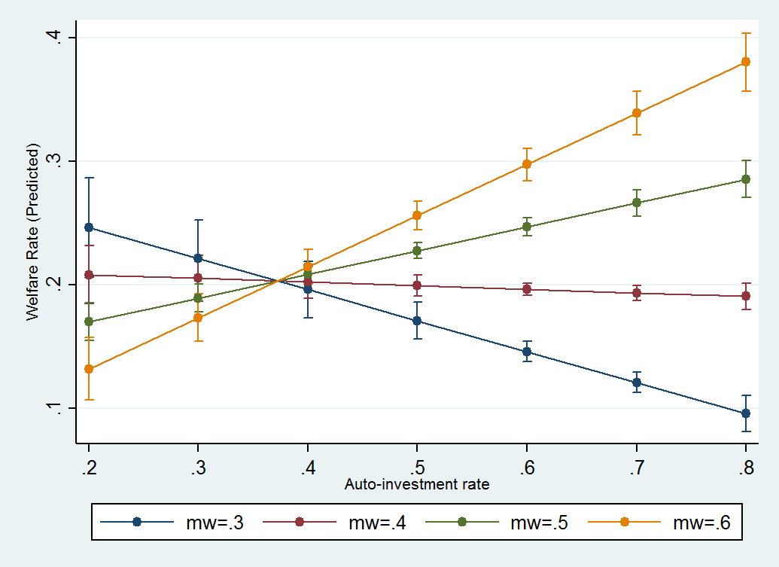
Introduction
Research question
Findings
Why is it important
Literature review
Hypotheses
Technical details
Results
Conclusion
Future research

Slide 17
We found no empirical support for the poor chasing the rich hypothesis
Local politicians can use these findings to advocate for greater decentralization of spending powers
Lower-income residents are better served in cities that enjoy greater municipal autonomy and that exhibit greater demand for welfare services
Introduction
Research question
Findings
Why is it important
Literature review
Hypotheses
Technical details
Results
Conclusion
Future research

Slide 18
Broaden the scope of this research with more yearly data (going back to mid-1990’s)
Measure the quality of welfare services offered as well as the expenditures on welfare services
Duplicate this study in other countries
Continue to measure cities behavior with quantitative tools, investigate urban problems to offer data-driven solutions
Introduction
Research question
Findings
Why is it important
Literature review
Hypotheses
Technical details
Results
Conclusion
Future research

Slide 19
In God we trust.
Everyone else -
bring data
Michael Bloomberg

